Slide 1
CS 2212
Introduction to Software Engineering
Chapter 9 Design Concepts

Slide 2
Copyright Notice This Presentation and Its Associated Video Contain Copyright Material. This Presentation and Its Associated Video Are Provided for Teaching Purposes of CS2212 and Should Not Be Posted In Any External Site, Or Shared with. This Presentation and Its Associated Video Are Provided For Instructional Personal Use Only, and Only For The Purposes of the CS2212 Course.

Slide 3
Part 22
The Design Model
Making code do what it's supposed to do is the easy part. Handling the myriad ways it can go wrong is the real work.
- @ajlozier
Notes:
This lesson introduces the basic steps in a software engineering project at a high level.
In practice, steps often overlap.

Slide 4
Learning Objectives in this Part
To understand the concept of software design and its goals
To be introduced to the fundamentals of the software design process and of the software design model
To be introduced on quality consideration issues while compiling a software system’s design model

Slide 5
Software Design
The Software Design process is transforming the Analysis model (i.e. the Requirements model) to a Design model. It encompasses the set of principles, concepts, and practices that lead to the development of a high quality system or product.
Design principles, concepts, and practices establish an overriding philosophy that guides the designers as they create the design models.
Software design practices change continuously as methods evolve.

Slide 6
Design in the Context of Software Engineering
Architectural design – Identifies major structural elements and defines relationships which will be materialized as connectors among these major software structural elements.
Component-level design – transforms structural elements into procedural descriptions of software components.
Interface design – defines how software elements, hardware elements, and end-users communicate.
Data/Class design – transforms analysis classes into implementation classes and data structures.

Slide 7
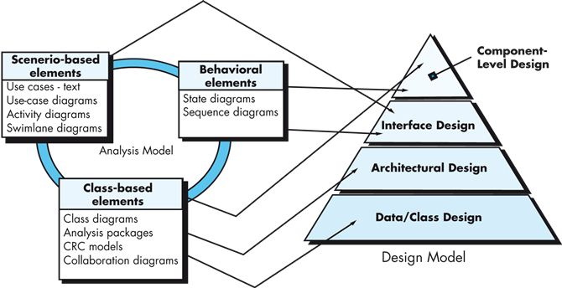
Design in the Context of Software Engineering Models

Slide 8
Architectural Design
The architectural design is depicted as a set of interconnected subsystems.
Subsystems are referred as Components and interconnections as Connectors.
The Components and their Connectors are often derived by analyzing the system’s requirements forming what we call the system’s Architecture.
In a good design, the Components are interconnected using architectural patterns which belong to an architectural style.
Each subsystem may have its own internal architecture so that a system’s overall architecture can be an amalgamation of different architectural styles. These types of architectures are called heterogeneous architectures.

Slide 9
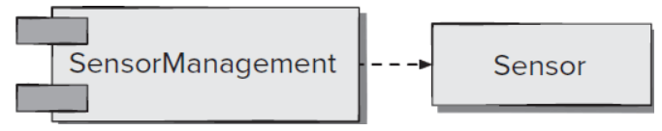
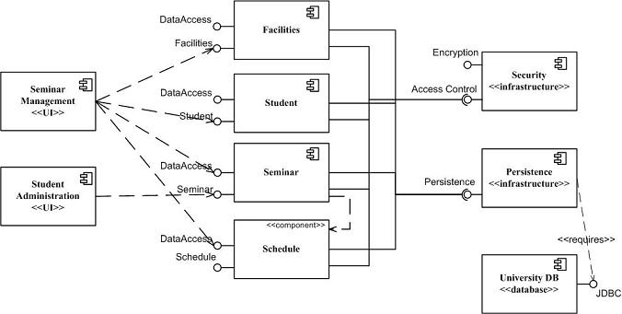
Component level Design
Related classes which are highly cohesive (exhibit a degree of high cohesion) can be grouped together to form Components. Components expose interfaces to be used by other components.
The way components are connected defines the system’s architecture.
The component which offers the interface can be considered as the “server” component while the component which uses this interface is considered as “client” component in this connection.
As we have seen, we use UML Component Diagrams to model the components, their exposed interfaces, and the connections between the different components.
Two different examples of Component Diagrams

Slide 10
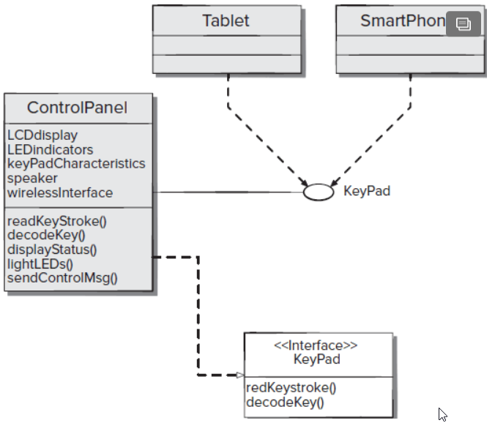
Interface Design
There are three important elements of interface design:
The user interface (UI);
External interfaces to other systems, devices, networks, or other producers or consumers of information and;
Internal interfaces between various design components.
We focus here on the External and Internal interfaces.
The design of external interfaces requires definitive information about the entity to which information is sent or received.
The design of internal interfaces is closely aligned with component-level design.
Interface specification implemented by the ControlPanel class

Slide 11
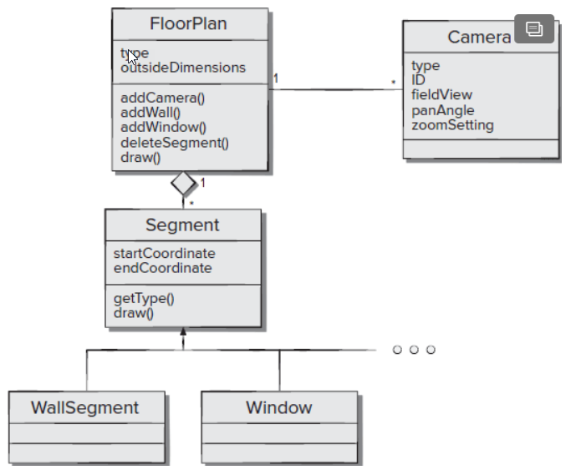
Data / Class Design
The analysis model defines a set of analysis classes. As we have said, this set is referred to as the Domain Model.
Each of such class in the Domain Model describes some element of the problem domain as extracted from the use cases during the requirements analysis phase of the Software Lifecycle.
For the Design Model we define a set of design classes that refine the analysis classes by providing design detail that will enable the classes to be implemented and to create a software infrastructure that supports the requirements of the specific application being developed.

Slide 12
Software Design Principles
The design process should not suffer from “tunnel vision”
The design should be traceable to the analysis (i.e. requirements) model
The design should not reinvent the wheel
The design should “minimize the intellectual distance” between the software and the problem as it exists in the real world
The design should exhibit uniformity and integration
The design should be structured and modular in order to accommodate change

Slide 13
Software Design Principles
The design should be structured to degrade gently, even when aberrant data, events, or operating conditions are encountered.
Design is not coding, coding is not design.
The design should be assessed for quality as it is being created, not after the fact*.
The design should be reviewed to minimize conceptual (semantic) errors.
* Check out this interesting article on how to assess a software design
https://moodle.polymtl.ca/pluginfile.php/517017/mod_resource/content/1/measurement_software_design_quality.pdf

Slide 14
List of Design Goals
Reliability
Modifiability
Maintainability
Understandability
Adaptability
Reusability
Efficiency
Portability
Traceability of requirements
Fault tolerance
Backward-compatibility
Cost-effectiveness
Robustness
High-performance
Good documentation
Well-defined interfaces
User-friendliness
Reuse of components
Rapid development
Minimum # of errors
Readability
Ease of learning
Ease of remembering
Ease of use
Increased productivity
Low-cost
Flexibility

Slide 15
Relationship Between Design Goals
End User
Low cost
Increased Productivity
Backward-Compatibility
Traceability of requirements
Rapid development
Flexibility
Functionality
User-friendliness
Ease of Use
Ease of learning
Fault tolerant
Robustness
Runtime
Efficiency
Reliability
Portability
Good Documentation
Client
Minimum # of errors
Modifiability, Readability
Reusability, Adaptability
Well-defined interfaces
Developer/
Maintainer

Slide 16
Typical Design Trade-offs
Performance vs. Reusability
Cost vs. Robustness
Efficiency vs. Portability
Rapid development vs. Functionality
Cost vs. Reusability
Backward Compatibility vs. Readability

Slide 17
The Design Process
Throughout the design process, the quality of the evolving design must be assessed; three recommended characteristics that serve as a guide for the evaluation of a good design are:
The design must implement all of the explicit requirements contained in the analysis model, and it must accommodate all of the requirements desired by the customer
The design must be a readable and serve as a clear guide for the developers of the system’s code and for those who will test and subsequently support the software
The design should provide a complete picture of the software, addressing data, functional, and non-functional aspects of the system, from an implementation perspective

Slide 18
Generic Task Set for Design (1)
Examine the information model, and design appropriate data structures for data objects and their attributes.
Using the analysis model (i.e. the requirements model), select an architectural style (pattern) that is appropriate for the software.
Partition the analysis model into design-level subsystems and allocate these subsystems within the architecture:
Be certain that each subsystem is functionally cohesive.
Design subsystem interfaces.
Allocate analysis classes or functions to each subsystem.

Slide 19
Generic Task Set for Design (2)
Create a set of design classes or components:
Translate classes from the domain model into a design-level classes.
Check each design class against design criteria; consider inheritance issues.
Define methods and messages associated with each design class.
Evaluate and select design patterns for a design class or a subsystem.
Review design classes and revise as required.
Specify all algorithms within each class or component identified at a relatively low level of abstraction.
Refine the interface of each component.
Define component-level data structures.
Review each component, and correct all errors uncovered.
6. Repeat steps 3 – 5 so that a stable design model can be achieved.
7. Develop a deployment model.

Slide 20
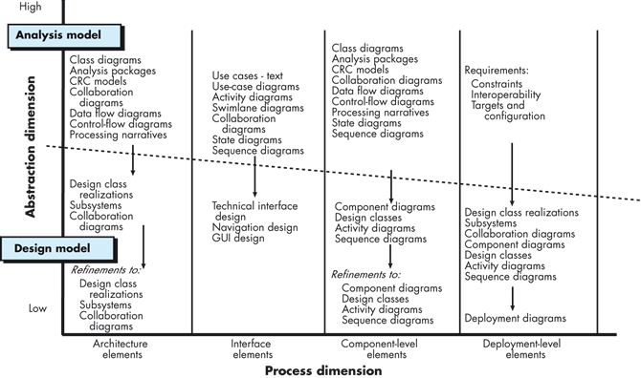
The Design Model

Slide 21
Design Model Principles
Principle 1. Design should be traceable back to the requirements model.
Principle 2. Always consider the architecture of the system to be built, and utilize architectural templates and styles as appropriate.
Principle 3. Design of data (i.e. the information model) is as important as design of processing functions.
Principle 4. Interfaces (both internal and external) must be designed with care.
Principle 5. User interface design should be tuned to the needs of the end user.

Slide 22
Design Model Principles
Principle 6. Component-level design should be functionally independent.
Principle 7. Components should be loosely coupled to one another and to the external environment.
Principle 8. Design representations (models) should be easily understandable.
Principle 9. The design should be developed iteratively.
Principle 10. Creation of a design model does not preclude an agile approach.

Slide 23
Guidelines for Design Quality (Summary)
A design should exhibit an architecture that (1) has been created using recognizable architectural styles or patterns, (2) is composed of components that exhibit good design characteristics* and (3) can be implemented in an evolutionary fashion.
A design should be modular; that is, the software should be logically partitioned into elements or subsystems.
A design should contain distinct representations of data, architecture, interfaces, and components
* Cohesion, coupling, modularity

Slide 24
Software Quality Guidelines (Summary)
A design should lead to data structures that are appropriate for the classes to be implemented and are drawn from recognizable data patterns.
A design should lead to components that exhibit independent functional characteristics.
A design should lead to interfaces that reduce the complexity of connections between components and with the external environment

Slide 25
Guidelines for Design Quality
A design should be derived using a repeatable method that is driven by information obtained during software requirements analysis.
A design should be represented using a notation that effectively communicates its meaning.
The above design guidelines are not achieved by chance; they are achieved through the application of fundamental design principles, systematic methodology, and thorough review.

Slide 26
Your Turn
Explain why in some systems there may exist design trade-offs between a) Functionality vs. Usability, b) Cost vs. Robustness and, c) Efficiency vs. Portability.
What are the benefits of having a design to exhibit an architecture that has been created using recognizable architectural styles or patterns?
Explain why the design of data is as important as the design of processing functions.
Check-out the content of the following sites:
https://en.wikipedia.org/wiki/Software_design
https://www.tutorialspoint.com/software_engineering/software_design_basics.htm
https://hackernoon.com/10-oop-design-principles-every-programmer-should-know-f187436caf65

